Slide 1

CUSTOMER RETENTION DATASET

Slide 2
INTRODUCTION
Customer satisfaction has emerged as one of the most important factors that guarantee the success of online store; it has been posited as a key stimulant of purchase, repurchase intentions and customer loyalty. A comprehensive review of the literature, theories and models have been carried out to propose the models for customer activation and customer retention. Five major factors that contributed to the success of an e-commerce store have been identified as: service quality, system quality, information quality, trust and net benefit. The research furthermore investigated the factors that influence the online customers repeat purchase intention. The combination of both utilitarian value and hedonistic values are needed to affect the repeat purchase intention (loyalty) positively. The data is collected from the Indian online shoppers. Results indicate the e-retail success factors, which are very much critical for customer satisfaction.
Customer retention includes all actions taken by organization to guarantee customer loyalty and reduce customer. Different statistical and machine-learning techniques are used to address this problem. Machine-learning techniques have been widely used for evaluating the probability of customer.

Slide 3
Hardware and Software Requirements and Tools Used
RAM: 8GB
ROM: I3 processor
SOFTWARE: Python 3.9.6
LIBRARIES: Numpy, Pandas, Seaborn, Sklearn, Scipy .
Tools: Jupiter notebook, Matplotlib, Scikit-learn, Excel.
Testing of Identified Approaches (Algorithms)
Decision Tree Classifier
Logistic Regression
Random Forest Classifier
SVC
KNeighborsClassifier

Slide 4
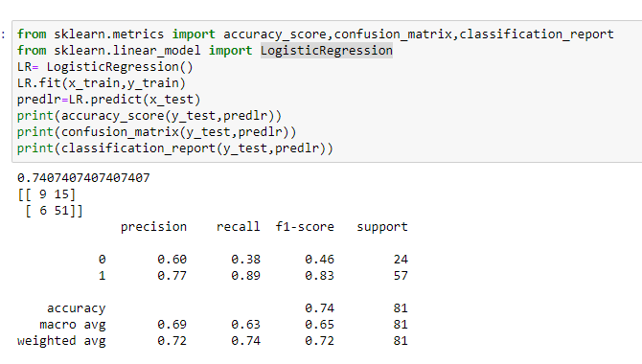
Logistic Regression
Run and Evaluate selected models
MODELS
Logistic Regression

Slide 5
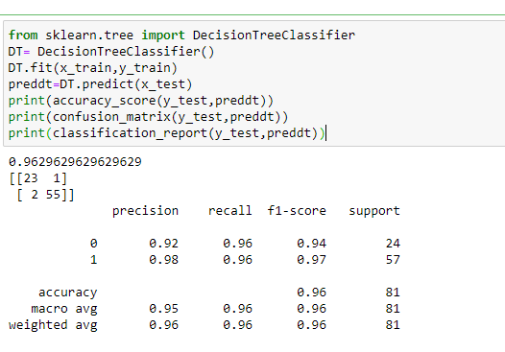
Decision Tree Classifier

Slide 6
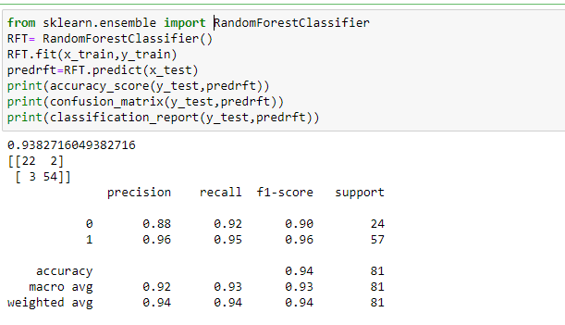
Random Forest Classifier

Slide 7
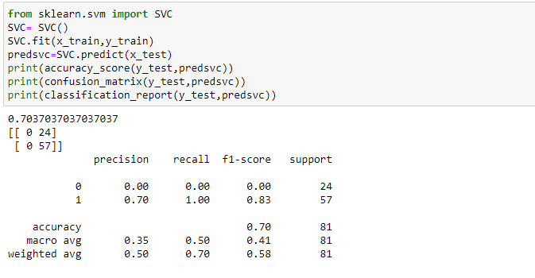
SVC

Slide 8
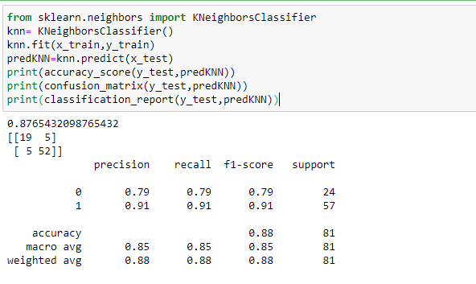
KNeighborsClassifier

Slide 9
CONCLUSION
In these project, Decision Tree Classifier, Random Forest Classifier, Logistic Regression, SVC, KNeighborsClassifier these models are used.
In these project, we are getting highest accuracy with DecisionTreeClassifier (96%) and also cross validation score is best than other models.
Minimum difference in accuracy and cross validation score is for Decision Tree Classifier So this is our best model.

Slide 10
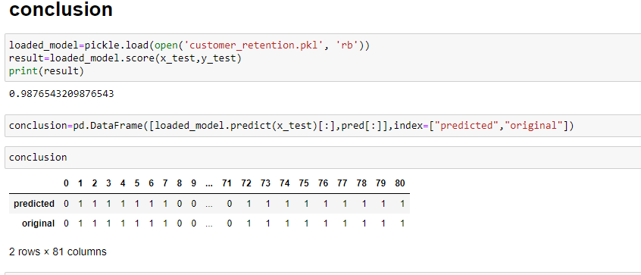

Slide 11
THANK YOU

